Slide 1
Deep Learning for Mobile Computing and Wireless Applications
Presenter: Xuyu Wang

Slide 2
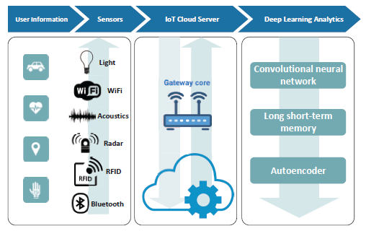
RF sensing in IoT
Framework of RF sensing in Internet of Things
Notes:
This is a framework of RF sensing in Internet of Things.
Many applications benefit from the development of the IoT. In general, IoT based applications consist of three layers: the sensing layer, the gateway layer, and the cloud layer.
the left block shows the sensing layer. Sensed data is usually captured by different RF sensors, such as WiFi, Bluetooth, Radar,and RFID, in this layer. In fact, RF signals are transmitted, reflected, and blocked by objects like walls, furniture, vehicles, or human body. So, it is possible to extract useful information, such as position, movement direction, speed, and vital signs of a human subject, from received RF signals.
The gateway layer (the middle block) is to transfer sensed signals to the cloud layer (the right block). Usually captured signals are analyzed in the cloud layer with some signal processing techniques or machine learning algorithms. Recently, there has been considerable interest in applying deep learning techniques such as deep autoencoder, convolutional neural network (CNN), and long short-term memory (LSTM) for RF sensing.

Slide 3
Deep Learning
Definition:
A branch of machine learning that models high-level abstractions in data by using model architectures
For classification tasks, higher layers of representation amplify aspects of the input that are important for discrimination
Layers of features: learned from data using a general-purpose learning procedure
Advantages:
Handle the large dataset and complex classification tasks
Obtain higher classification accuracy
Process high dimensional data
Y. LeCun, Y. Bengio, and G. Hinton, “Deep learning,” Nature, vol. 521, pp.436-444, May 2015.
Notes:
Deep learning is a branch of machine learning that can model high-level abstractions in data by using model architectures, composed of multiple non-linear transformations.
For classification tasks, higher layers of representation amplify aspects of the input that are important for discrimination.
The key point of deep learning is that these layers of features are not designed by human engineers: they are learned from data using a general-purpose learning procedure.
deep learning can handle the large dataset and complex classification tasks, which can obtain higher classification accuracy. also, deep learning algorithms also have great potential to process high dimensional data that could not be handled by shallow machine learning algorithms.
-----------------------------------
An image, for example, comes in the form of an array of pixel values, and the learned features in the first layer of representation typically represent the presence or absence of edges at particular orientations and locations in the image. The second layer typically detects motifs by spotting particular arrangements of edges, regardless of small variations in the edge positions. The third layer may assemble motifs into larger combinations that correspond to parts of familiar objects, and subsequent layers would detect objects as combinations of these parts.

Slide 4
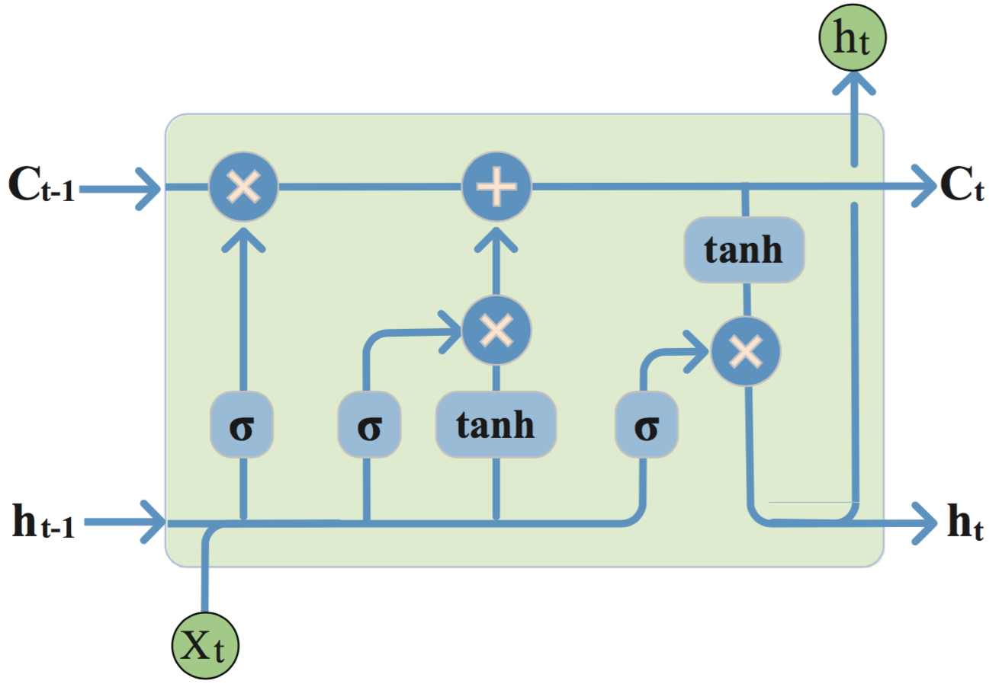
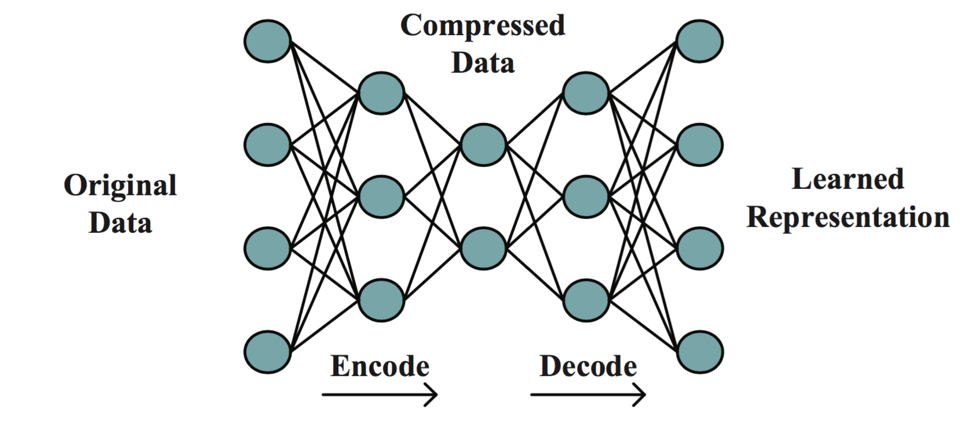
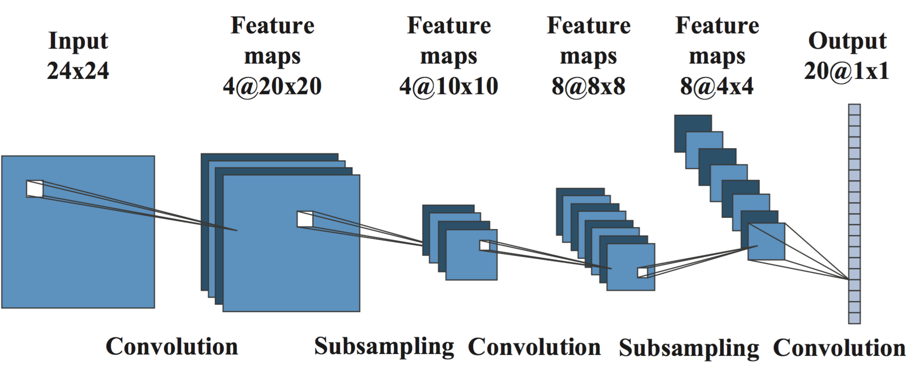
Deep Learning Networks
Autoencoder
CNN
LSTM
Notes:
An autoencoder neural network is an unsupervised learning algorithm for data compression and signal denoising. It wants to generate the output that is an approximation of the input. There are three stages in the training process, including pretraining, unrolling, and fine-tuning.
Convolutional neural network (CNN) is a supervised learning, which has achieved a great success in computer vision. From the figure, convolutional layer and subsampling layer are used for obtaining the feature of input data. After two groups of such computation, the output of the higher layer is processed by a fully connected layer, where a softmax function can be used for classification.
The LSTM model is developed to process variable-length input sequences. Basically, an LSTM unit emplys three gates to control the data flow including an input gate, a forget gat and an output gate. LSTM has been used widely for machine translation, speech recognition, and time-series prediction.
____
In the pretraining stage, each neighboring set of two layers is modeled as a Restricted Boltzmann Machines. Then the deep network is unrolled to get output with forward propagation. Next, the backpropagation technique is used to fine-tune the results.
An input gate decides if a new value could flow into the memory; a forget gate controls if a value should remain in memory; and an output gate determines if the value in memory could be used to compute the output of the unit.

Slide 5
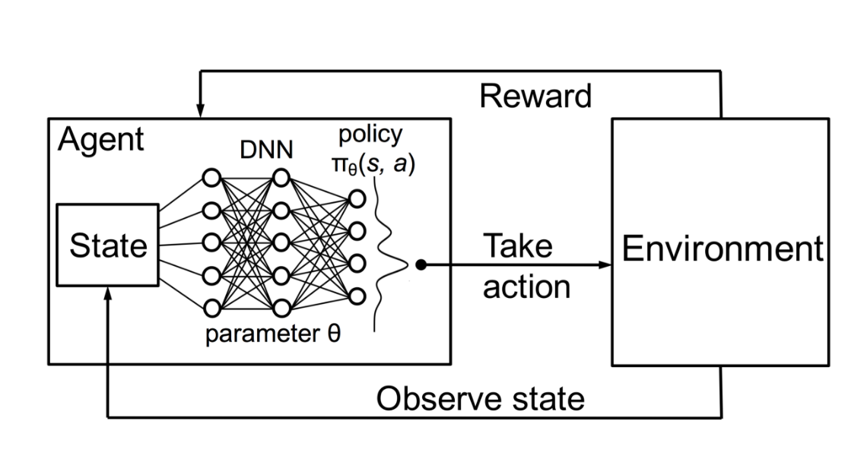
Deep Reinforcement Learning

Slide 6
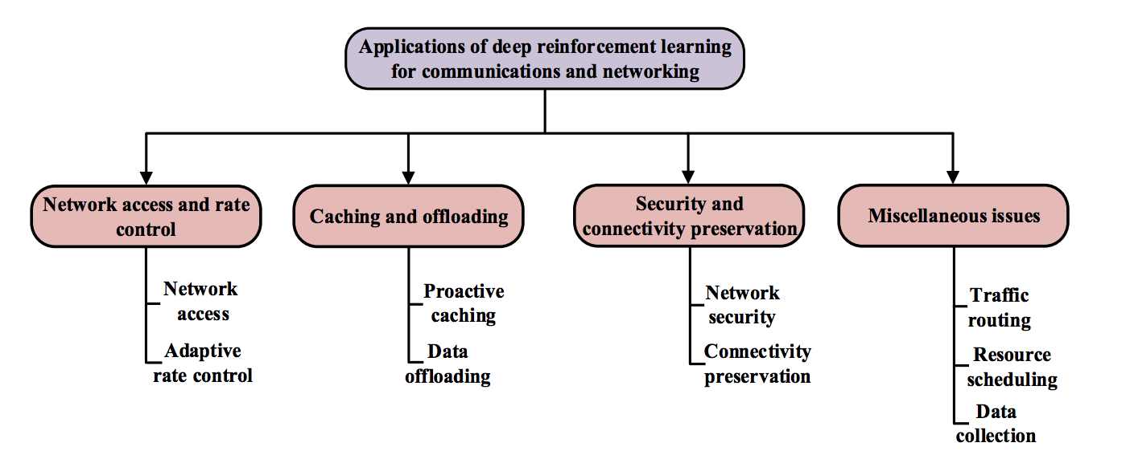
Wireless Networking
Luong, N. C., Hoang, D. T., Gong, S., Niyato, D., Wang, P., Liang, Y. C., & Kim, D. I. (2018). Applications of Deep Reinforcement Learning in Communications and Networking: A Survey. arXiv preprint arXiv:1810.07862.

Slide 7
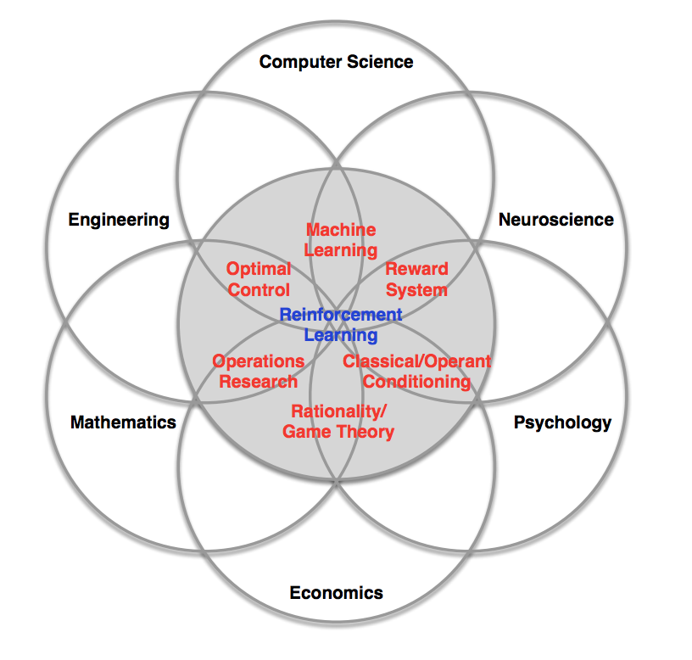
Applications

Slide 8
Wireless Internet protocol stack
application: supporting network applications
FTP, SMTP, HTTP
transport: process-process data transfer
TCP, UDP
network: routing of packets from source to destination
IP, routing protocols
link: data transfer between neighboring network elements
Ethernet, 802.11 (WiFi), PPP
physical: bits “on the wire” or wireless
application
transport
network
Link (MAC)
physical
Notes:
We will cover the entire spectrum of the networking stack from a wireless perspective .. Starting with the physical layer ..

Slide 9
Deep Learning
in Physical Layer Communications
Adapted from Ye Li

Slide 10
Motivation
Challenges in current communication systems
Mathematical channel models versus practical channel imperfection
Block structures versus global optimality
Effective signal processing algorithms versus low costs
Why deep learning?
Data-driven method, no need for channel models
End-to-end loss optimization for global optimality
Concurrent architectures, suitable in fast-developing parallelized processing architectures
Z.-J. Qin, H. Ye, G. Y. Li, and B.-H. Juang, “Deep learning in physical layer communications,” submitted
to IEEE Commun. Mag., July 2018.

Slide 11
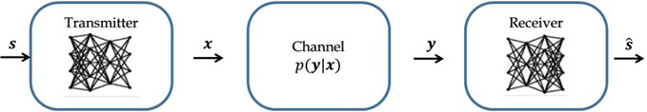
Block Structure or End-to-End?
Transmitter
Receiver
𝒔
Error- Correction Coding
Precoding- coding/pro cessing for BF
Demodulation and Signal Detection
𝒔ො
Modulation
Channel
Channel Estimation
Decoding

Slide 12
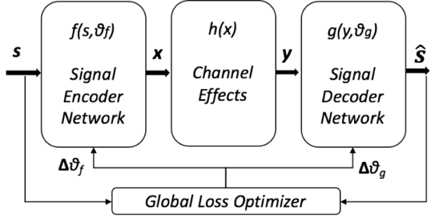
https://devblogs.nvidia.com/deepsig-deep-learning-wireless-communications/

Slide 13
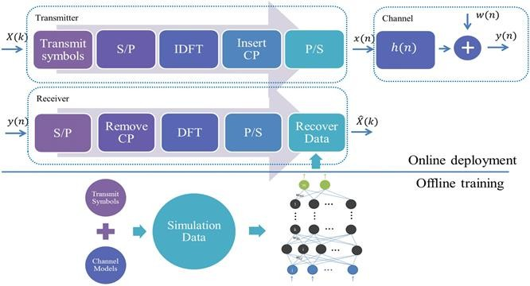
Joint Channel Estimation and Signal Detection
Pilot OFDM block + data OFDM block
Channel varying frame-to-frame, constant over pilot and data blocks
H. Ye, G. Y. Li, and B.-H. F. Juang, “Power of deep learning for channel estimation and signal detection in OFDM systems,” IEEE WCL, vol. 7, no. 1, pp. 114 – 117, Feb. 2018.

Slide 14
DNN Model Training
Training to predict the transmit data
Training with received OFDM samples generated under diverse channel conditions
Optimizing parameters to minimize distance of model output and transmit data

Slide 15
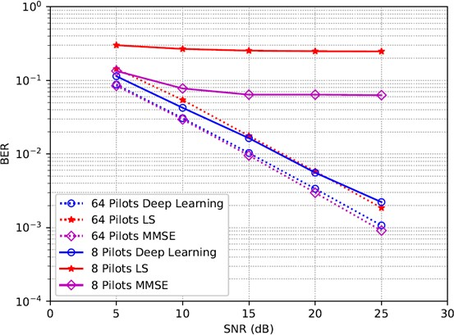
Impact of Pilot Number
Better than LS; comparable to MMSE
Better than MMSE with 8 pilots

Slide 16
End-to-End Learning based Communications
Background
Transmitter learns to encode the transmitted data into x
Receiver leans to recover the transmitted data based on y
Challenges:
Channel transfer function is unknown
Channel is time-varying
Approaches:
Reinforcement Learning
Conditional GAN
H. Ye, G. Y. Li, B.-H. Juang, and K. Sivanesan, “Channel agnostic end-to-end learning based communication systems with conditional GAN,” submitted to IEEE Global Commun. Conf., Abu Dhabi, UAE, Dec. 2018.

Slide 17
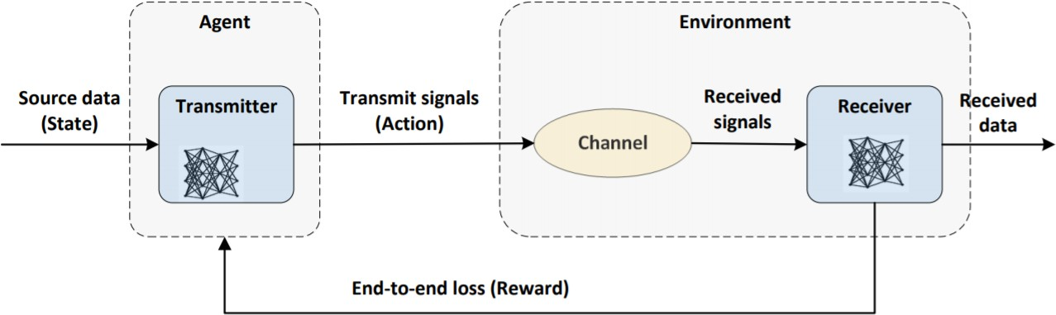
E2E based on Reinforcement Learning
Reinforcement Learning Formation:
Agent: transmitter
Environment: channel and receiver
States: source data
Actions: transmit signals
Advantage and Disadvantage:
Channel model is unnecessary
Reinforcement learning for continuous action space is hard

Slide 18
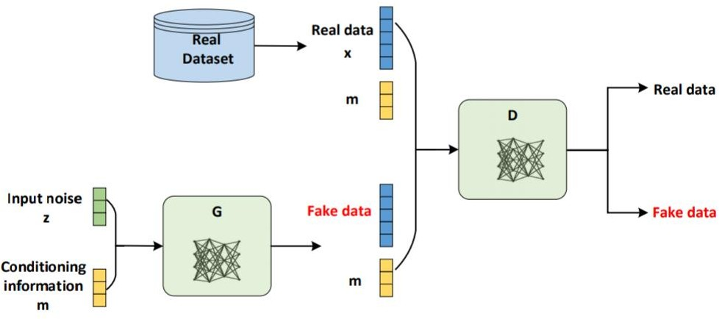
E2E based on Conditional GAN
GAN:
Generator: maps an input noise, z, to a sample
Discriminator: maximizes the ability to distinguish between the two categories
Conditional GAN:
Both G and D are conditioned on some extra information, m

Slide 19
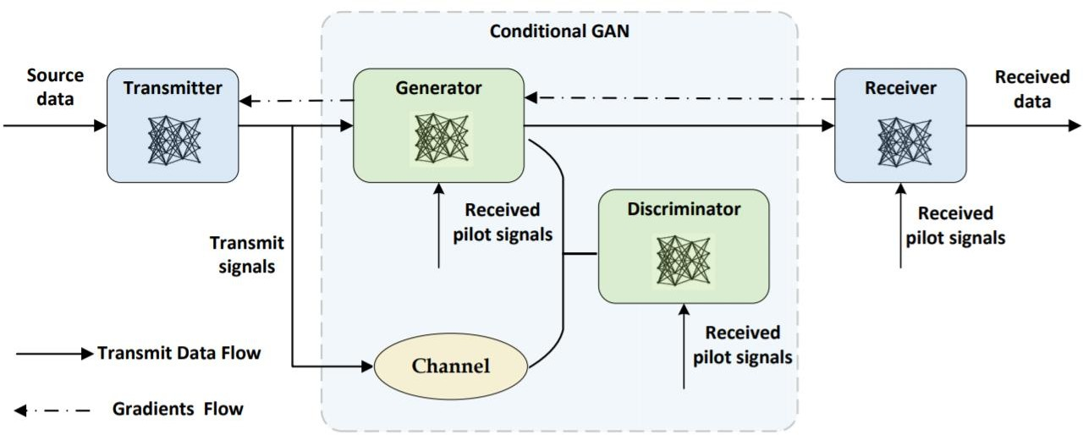
E2E based on Conditional GAN
Conditional GAN: model the channel output distribution
Surrogate of the real channel when training the transmitter
Received pilots as a part of conditioning for time-varying channel

Slide 20
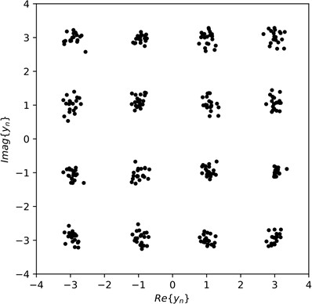
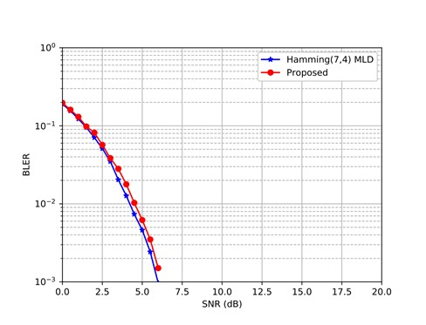
Simulation Results: AWGN Channels
Similar to AWGN with standard 16 QAM input
Similar to hamming(7,4) with MLD

Slide 21
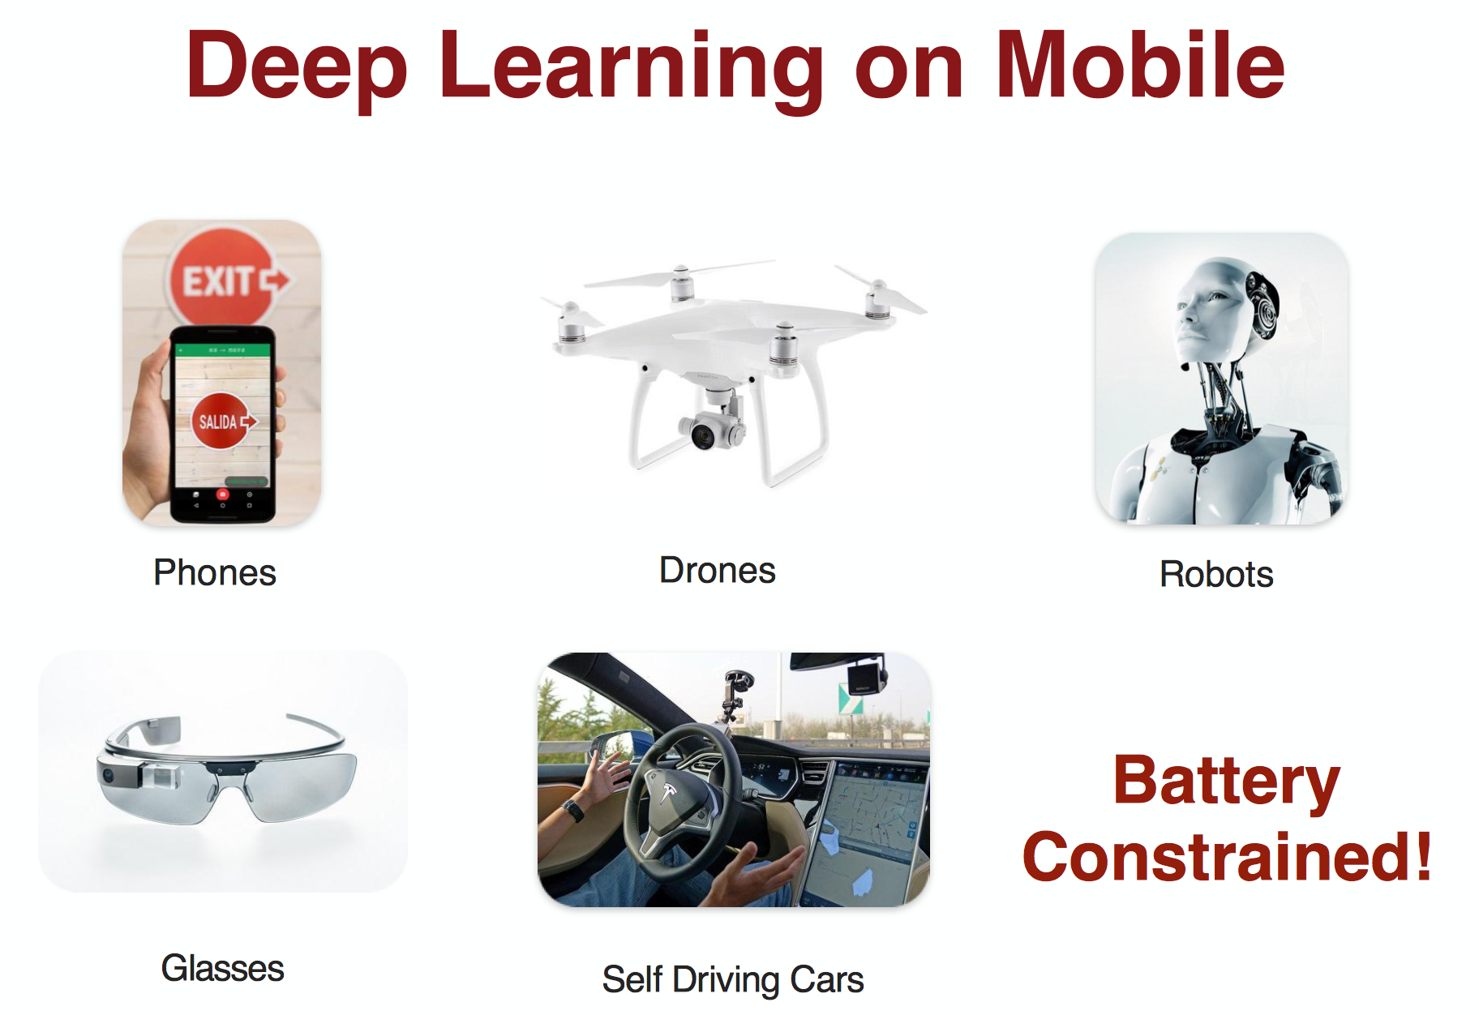
Source:
http://isca2016.eecs.umich.edu/wp-content/uploads/2016/07/4A-1.pdf

Slide 22
Motivation
Deep Neural Networks are BIG ... and getting BIGGER
e.g. AlexNet (240 MB), VGG-16 (520 MB)
Not suitable for low-power mobile/embedded systems
Solution: Deep Compression

Slide 23
Deep Compression
Technique to reduce size of neural networks without losing accuracy
Pruning to Reduce Number of Weights
Quantization to Reduce Bits per Weight
Huffman Encoding
“Deep Compression: Compressing Deep Neural Networks with Pruning, Trained Quantization and Huffman Coding”, Song Han et al., ICLR 2016

Slide 24
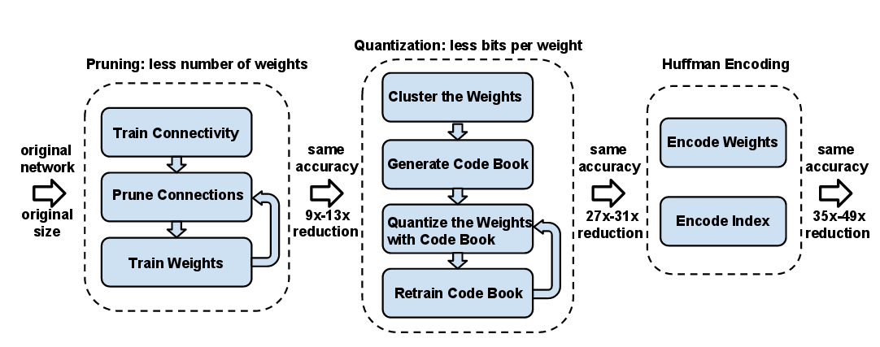
Deep Compression
“Deep Compression: Compressing Deep Neural Networks with Pruning, Trained Quantization and Huffman Coding”, Song Han et al., ICLR 2016

Slide 25
Pruning Results

Slide 26
Convolutional Neural Network on Cancer Image Dataset
Metrics | Uncompressed | Compressed
No. of parameters | 72,51,546 | 12,41,748
Precision Score | 0.71 | 0.70
Recall Score | 0.68 | 0.68
F1 Score | 0.70 | 0.71
Size of Model | 50 MB | 20.1 MB

Slide 27
Wi-Fi Fingerprinting based localization
Training phase
{RSS11,RSS12………RSS1P}
Location1
Fingerprint database
{RSS21,RSS22………RSS2P}
Location2
{RSS11,RSS12………RSS1P}
Location ith
{RSS’1,RSS’2…………………RSS’p}
ML Algorithm
Testing phase
Estimated Location

Slide 28
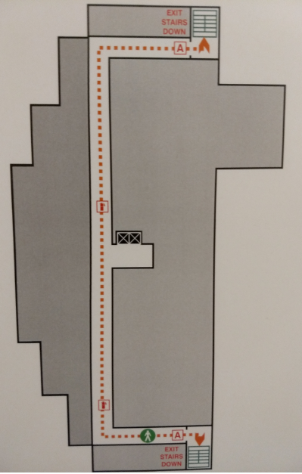
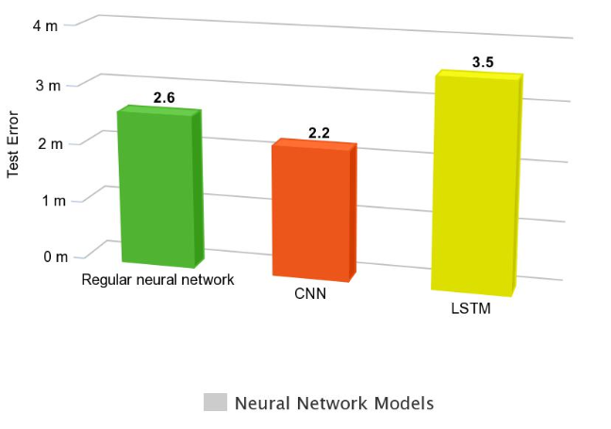
Results
3rd Floor Plan

Slide 29
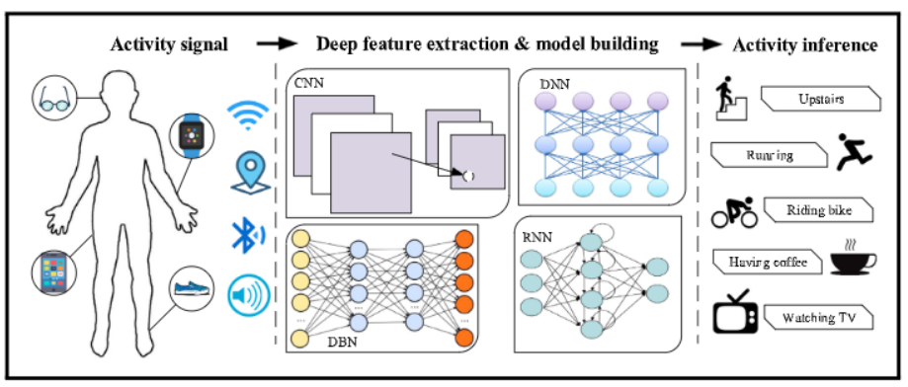
Sensor based Activity Recognition
Wang, J., Chen, Y., Hao, S., Peng, X., & Hu, L. (2019). Deep learning for sensor-based activity recognition: A survey. Pattern Recognition Letters, 119, 3-11.

Slide 30
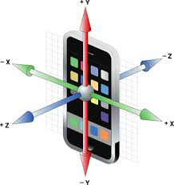
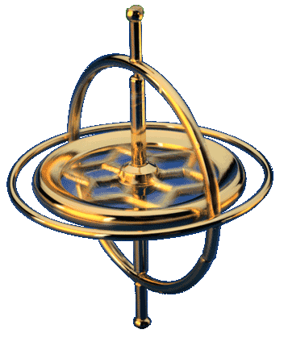
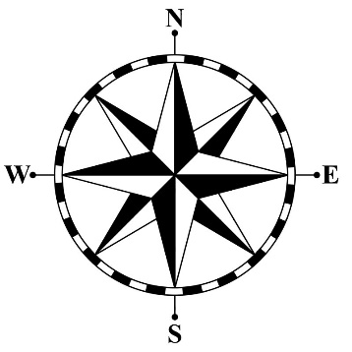
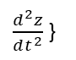
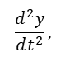
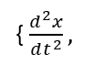
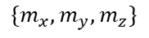
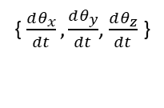
IMU (Inertial Measurement Unit)
Accelerometer
Gyroscope
Magnetometer (Compass)
Acceleration along 3 axes
Rotation speed around 3 axes
Direction of magnetic north
{ $\frac{d^{2}x}{dt^{2}},$
$$\frac{d^{2}y}{dt^{2}},$$
$\frac{d^{2}z}{dt^{2}}$ }
{ $\frac{dθ_{x}}{dt},\frac{dθ_{y}}{dt}$, $\frac{dθ_{z}}{dt}$ }
$$\{m_{x}, m_{y}, m_{z}\}$$

Slide 31
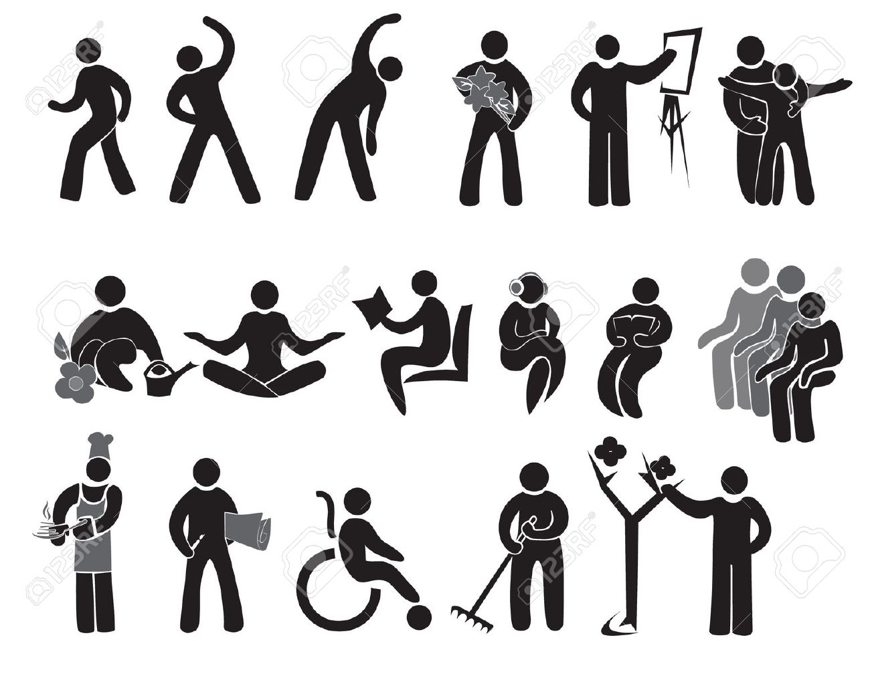
Smartphone Sensors: Accelerometer

Slide 32
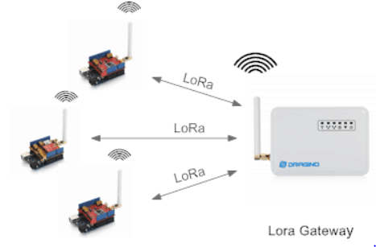
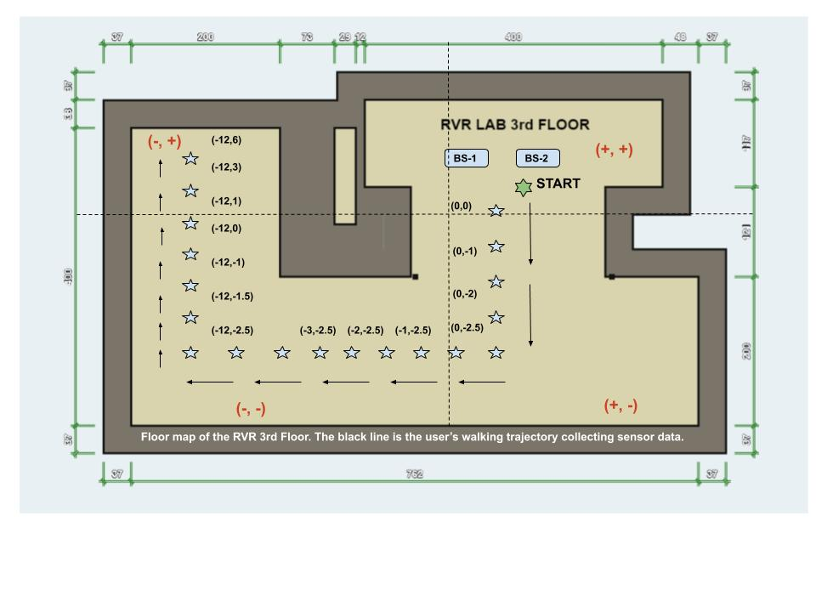
LoRa based Localization using Deep Learning Techniques
Offline Phase:
Send sensor data to LoRa Gateway (BS)
Log RSSI values from base-stations for different positions in database
Interpolation using denoising auto-encoders for replacing outliers and missing data
Generate Fingerprinting maps after interpolation
Online Phase:
Use fingerprinting maps for predicting location of test data based on various ML and Deep-Learning Algorithms
Solved by regression or classification techniques depending on the problem
Hyper-parameter Tuning optimizes DL results

Slide 33
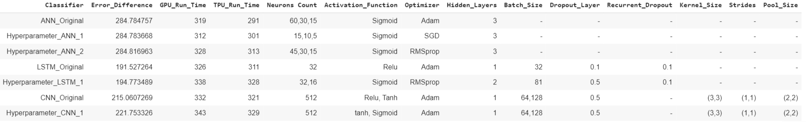
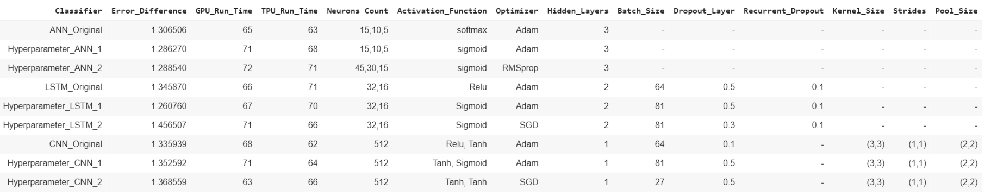
LoRa based Localization using Deep Learning Techniques
Outdoor Results
Indoor Results

Slide 34
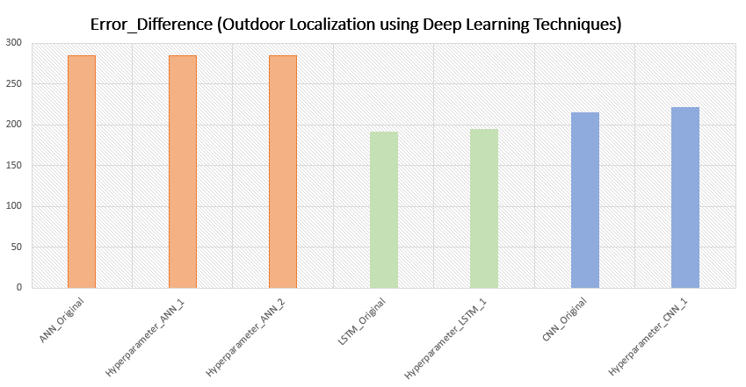
LoRa based Localization using Deep Learning Techniques

Slide 35
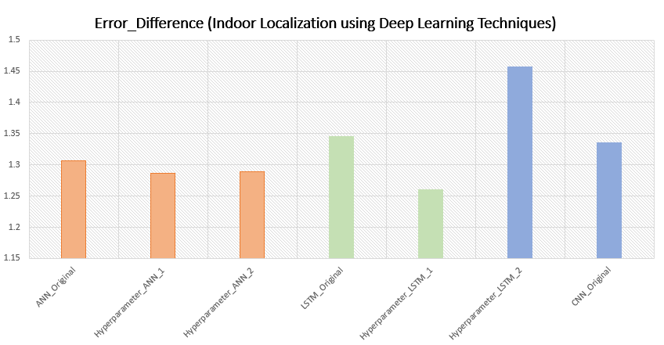
LoRa based Localization using Deep Learning Techniques

Slide 36


